Slide 1
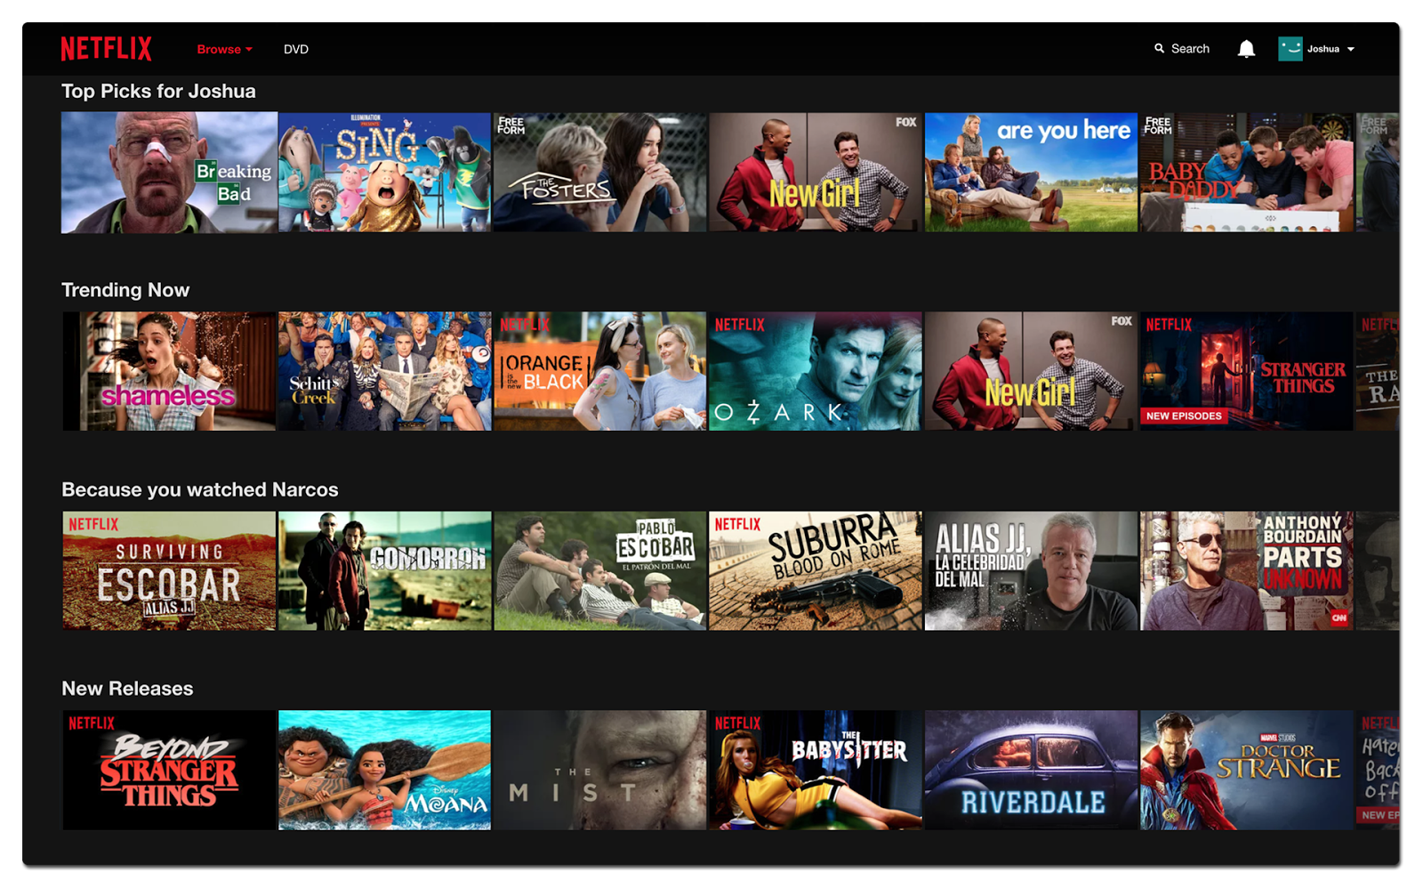
RECOMMENDATION SYSTEMS

Slide 2


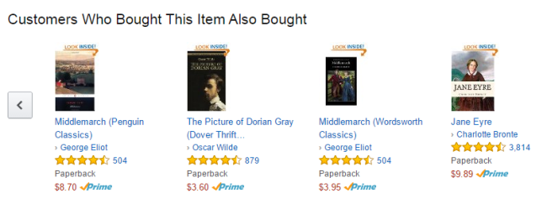
Recommendation Systems- Collaborative Filtering

Slide 3

Collaborative Filtering
If Person A has the same opinion as Person B on an issue, A is more likely to have B’s opinion on a different issue ‘X’, when compared to the opinion of a person chosen randomly

Slide 4
Traditional Collaborative Filtering
Customer as p-dimensional vector of items.
p: the no. of distinct catalog items
Components
Bought(1)/Not bought(0)
Ratings
Rt
Number of products purchased
Find Similarity between Customers A & B

Slide 5
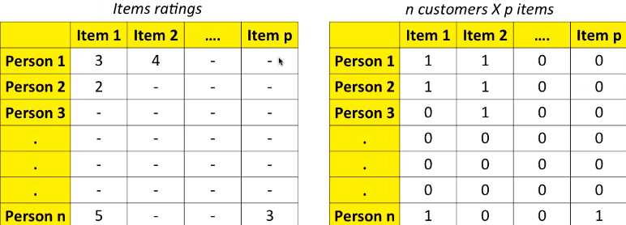
Collaborative Filtering
While computing similarity between persons 1 & 2, item 2’s rating cannot be included since person 2 hasn’t bought item 2
This is not an issue for binary data (bought/didn’t buy)

Slide 6
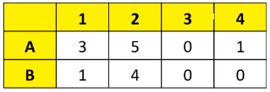
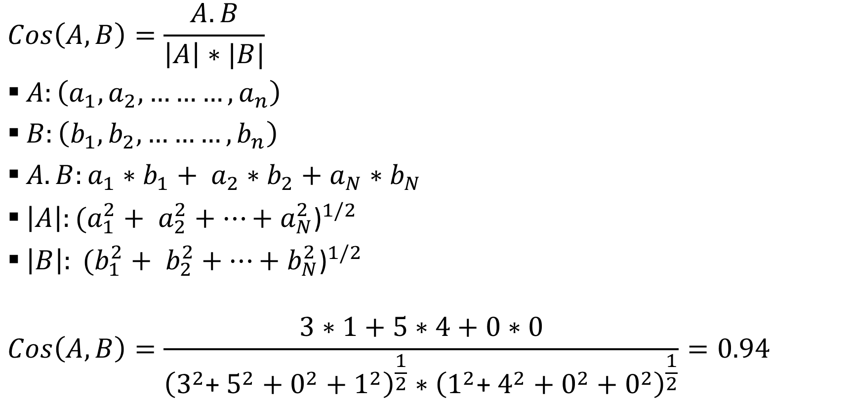

Similarity Measures
$$Cos\left(A,B\right)=\frac{A.B}{\left|A\right|∗|B|}$$
$A:\left(a_{1},a_{2},………,a_{n}\right)$
$B:\left(b_{1},b_{2},………,b_{n}\right)$
$A.B:a_{1}∗b_{1}+ a_{2}∗b_{2}+$ $a_{N}∗b_{N}$
$\left|A\right|:{(a_{1}^{2}+ a_{2}^{2}+…+a_{N}^{2}\text{)}}^{1/2}$
$\left|B\right|: {(b_{1}^{2}+ b_{2}^{2}+…+b_{N}^{2}\text{)}}^{1/2}$
$$Cos\left(A,B\right)=\frac{3∗1+5∗4+0∗0}{{\left(3^{2}\text{+} 5^{2}+0^{2}+1^{2}\right)}^{\frac{1}{2}}∗{\left(1^{2}\text{+} 4^{2}+0^{2}+0^{2}\right)}^{\frac{1}{2}}}=0.94$$
$$sim\left(i,j\right)=\cos\left(\vec{i},\vec{j}\right)=\frac{\overline{i}.\overline{j}}{{\left|\left|\overline{i}\right|\right|}_{2}∗{|\left|\overline{j}\right||}_{2}}$$

Slide 7
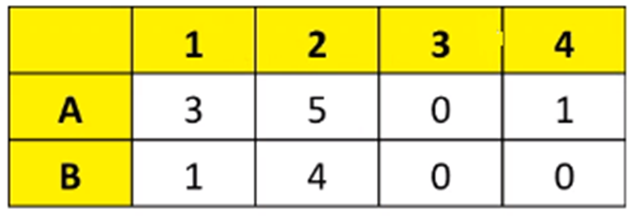
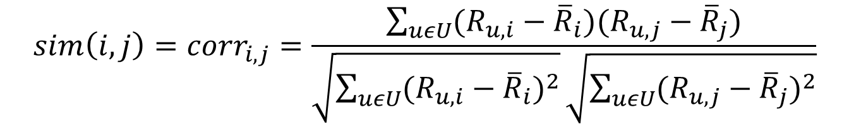

Similarity Measures
$$sim\left(i,j\right)={corr}_{i,j}=\frac{\sum_{uεU}{(R_{u,i}−{\overline{R}}_{i})(R_{u,j}−{\overline{R}}_{j})}}{\sqrt{\sum_{uεU}{{(R_{u,i}−{\overline{R}}_{i})}^{2}}}\sqrt{\sum_{uεU}{{(R_{u,j}−{\overline{R}}_{j})}^{2}}}}$$
$${Corr}_{AB}=\frac{Covariance(A,B)}{Stdev\left(A\right)∗Stdev(B)}$$

Slide 8
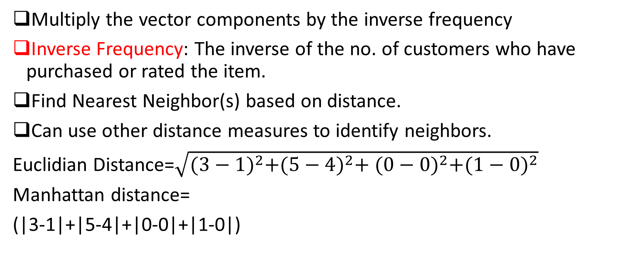
Normalization & Dissimilarity Things
Multiply the vector components by the inverse frequency
Inverse Frequency: The inverse of the no. of customers who have purchased or rated the item.
Find Nearest Neighbor(s) based on distance.
Can use other distance measures to identify neighbors.
Euclidian Distance=$\sqrt{{(3−1)}^{2}+{(5−4)}^{2}+ {(0−0)}^{2}+{(1−0)}^{2}}$
Manhattan distance=
(|3-1|+|5-4|+|0-0|+|1-0|)

Slide 9
What items to recommended?
→The item that hasn’t been bought by the user yet.
→Create a list of multiple items to be considered for recommendation & recommended the item that the person is MOST LIKELY to buy.
Rank each item according to how many similar customers purchased it
Or rated by most
Or highest rated
Or some other popularity criteria

Slide 10
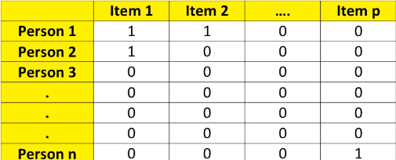

Disadvantages
Memory-based/Lazy-learning
→ When does the recommended engine compute the “recommendation”?
Computation-intensive
→Recall how it computes “recommendation”? $n^{2}$ similarities.

Slide 11
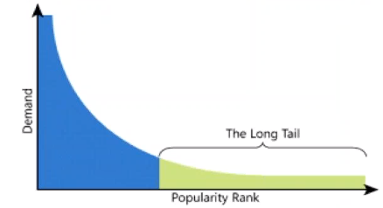
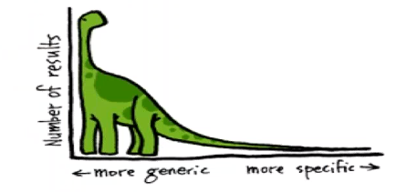
Long Tail
Supply-Side drivers:
Centralized warehousing with more offerings.
Lower inventory cost of electronic products.
Demand-Side drivers:
Search engines
Recommender Systems

Slide 12
How to reduce computation?
1. Randomly sample customers
2. Discard infrequent buyers
3. Discard items that are very popular or very unpopular
4. Clustering can reduce no. of rows
5. PCA can reduce number of columns

Slide 13
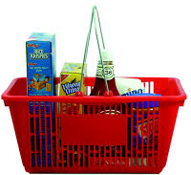

Runtime vs. Quality of recommendation
Recommend while the customer is browsing
Recommended better but later

Slide 14






Search-based Methods
Based on previous purchases to reduce computation
Books of the same/similar author
DVD titles of the same director
Products identified by similar keywords

Slide 15
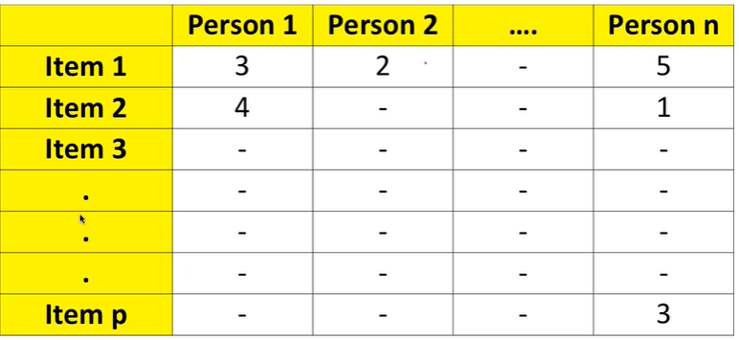
Similarity measure
While computing similarity between items 1 &2, Person 2’s rating cannot be included since Person 2 hasn’t bought item 2.

Slide 16
Item-to-Item collaborative filtering
Cosine similarity among items
Item being the vector
Customers as components of the vector
Correlation similarity among items
Correlation of ratings of items I&J where users rated both I&J.

Slide 17
Item-to-Item collaborative filtering
Scalability & Performance
Online component: lookup similar things for the user’s purchase ratings
Dependent only on how many tiles the user has purchased or rated
Computation-expensive, however similar- item table is computed offline

Slide 18
Item-to-Item collaborative filtering- Disadvantages
Less diversity between items, compared to the users’ taste, therefore, the recommendations are often obvious.
When considering what to recommend to a user, who purchased a popular item, the association rules or item-based collaborative filtering might yield the same recommendation, whereas the user-based recommendation will likely differ.

Slide 19
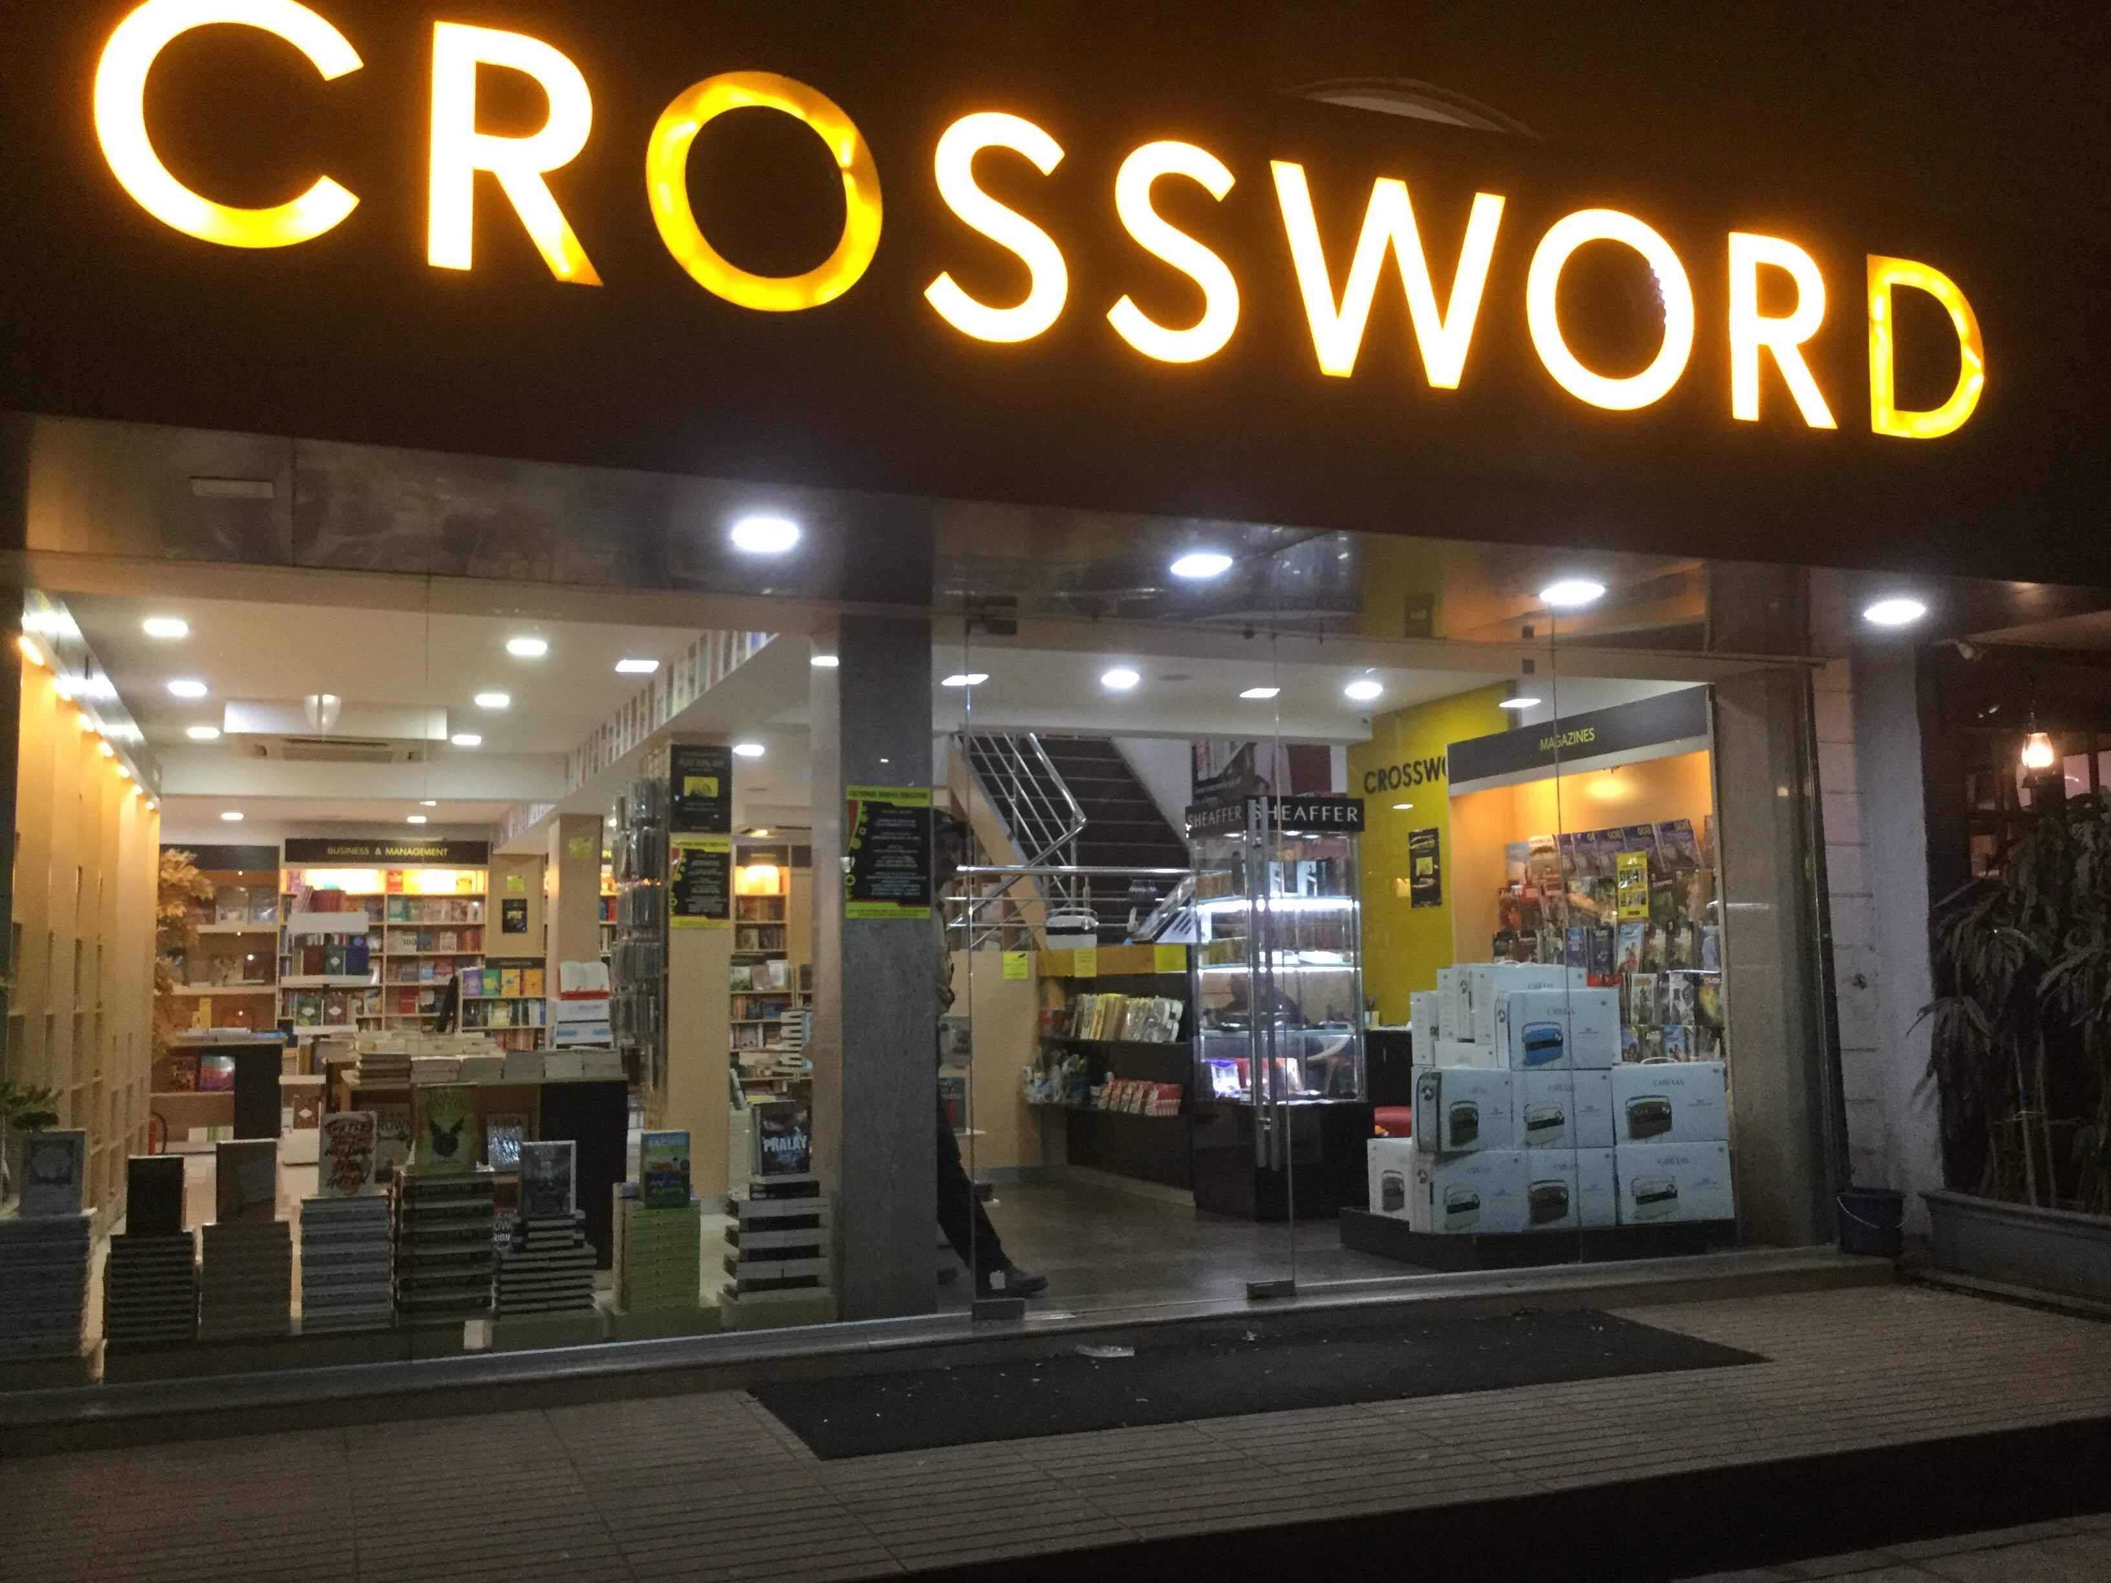
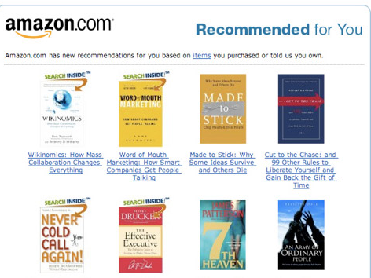
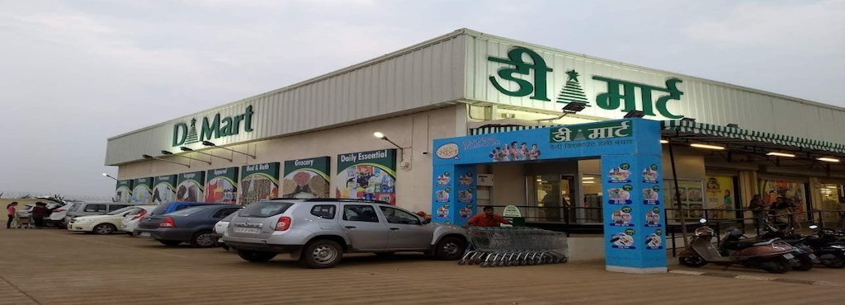
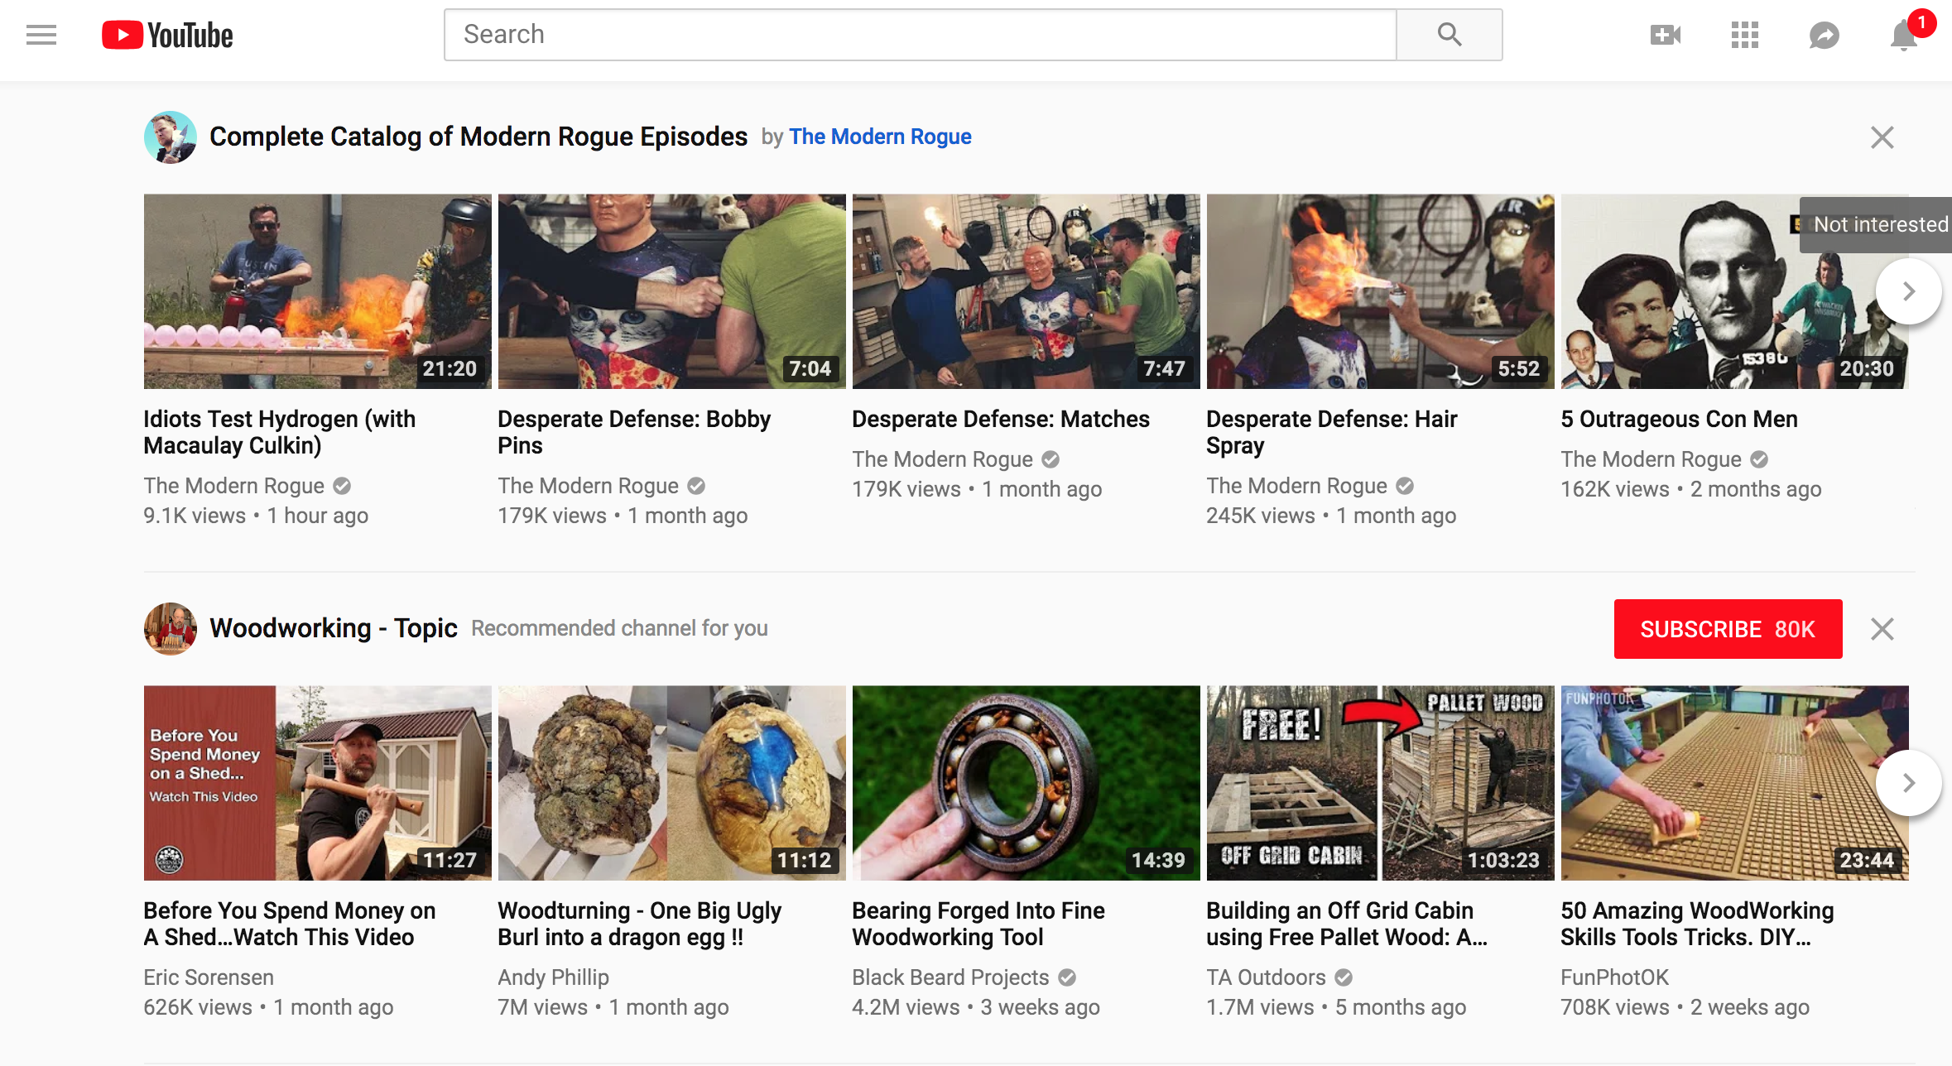
Dichotomies
Association Rules
Recommender Systems
Impersonal, common, Generic strategy
Number of baskets is important
Useful for large physical stores
Personalized strategy
Number of baskets is unimportant
Useful for online recommendation

Slide 20

New customer/Item
Popular items
Demographically relevant items
Browsing history
Secondary source of data- social media subscriptions
Netflix- start with rating a few movies/series
Recommended to random users
Recommend selective users based on certain criteria
How about offering the product to influential people on social media

Slide 21





Netflix’s Recommender System
- | - |  |  | -
- | - | - | - | -
 | - | 4 | - | -
 | - | - | 5 | -
- | - | - | - | -
Sparsity and Computational Burden

Slide 22
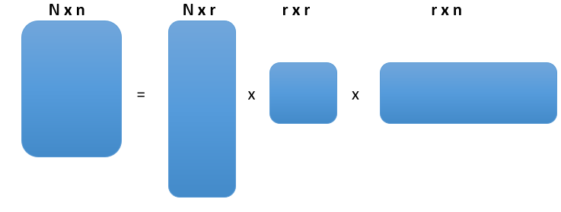
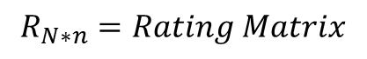


SVD – Preliminaries
X = UΣV^{T}
U & V are Orthonormal matrices
Orthonormal = Orthogonal + Unit Length (Normalize + Sum)
$$R_{N∗n}=Rating Matrix$$
$$U_{n∗2}=Item−Feature Matrix$$
$$U_{N∗r}=User−Feature Matrix$$

Slide 23
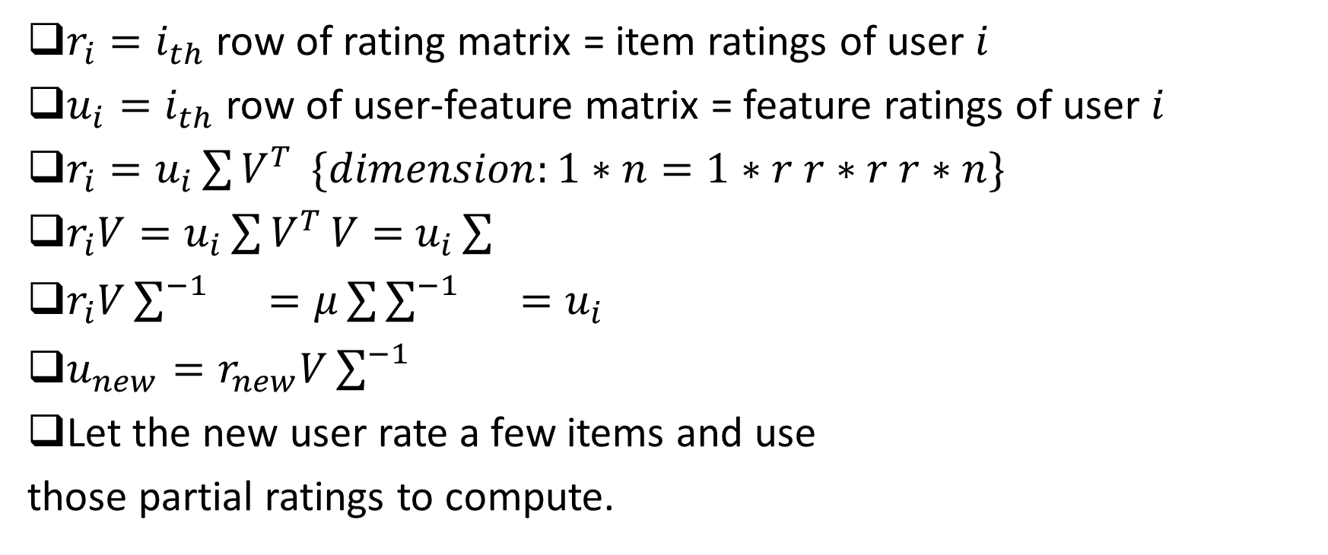
SVD in Recommendation for new Users
$r_{i}=i_{th}$ row of rating matrix = item ratings of user $i$
$u_{i}=i_{th}$ row of user-feature matrix = feature ratings of user $i$
$r_{i}=u_{i}\sum{V^{T}} \{dimension:1∗n=1∗r r∗r r∗n\}$
$r_{i}V=u_{i}\sum{V^{T}}V=$ $u_{i}\sum{}$
$r_{i}V\sum^{−1}{}=μ\sum{\sum^{−1}{}=u_{i}}$
$u_{new}=r_{new}V\sum^{−1}{}$
Let the new user rate a few items and use
those partial ratings to compute.
Missing Values: Impute the missing values in the Rank matrix with ‘user mean’ or ‘item mean’

Slide 24
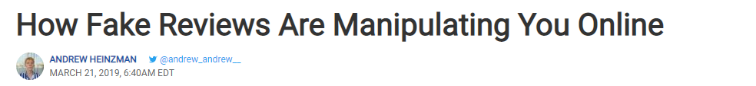
Vulnerability of Recommender Systems
Fake accounts are used to push a product by high ratings or kill a product by low ratings.
Accuracy of the recommendation & Neutrality is negatively impacted.
Have user authenticate before rating.
Mobile SMS code/Sign in using LinkedIn

Slide 25
Vulnerability of Recommender Systems
Privacy: Netflix doesn’t show users the preference of other users because the movie watching is very private to you & because of hacking issue.
SVD: a. Less transparent Algorithm
b. SVD Decomposition

Slide 26


Recommender System cases

Slide 27
NEXT TOPIC> NETWORK ANALYTICS

